Slide 1
CMSC848N : E16
BUILD A CODING AGENT
A.C.E - AGENTIC CODING ENGINE
Team Members:
Hemanth Nandakumar Quan Nguyen
Saketh Akella
Notes:
Quick Summary of our Work :
While the industry races toward trillion-parameter models, academic and resource-constrained environments are often left behind. Our work asks a fundamental question: Can we engineer agentic intelligence not by scaling up parameters, but by doing something different with the inference loop itself?

Slide 2

Contents
Motivation
Research Objectives
Related Work
Methodology
Implementation Details
Evaluation Results
Ablation Study
Conclusion
References

Slide 3
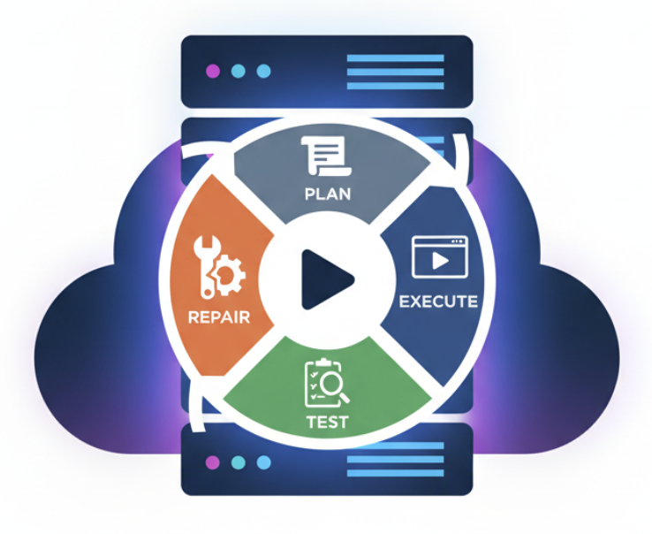
Motivation
Why Agentic Coding?
Single-shot LLM coding → often wrong for multi-step reasoning
Agentic systems (Plan → Execute → Test → Repair) show huge gains
BUT: almost all rely on large proprietary models (GPT-4, Claude)
Our Core Question
Can small, quantized, open-source models reliably perform full transparent agentic workflows?
Notes:
So, why 'Agentic' Coding?
For Standard LLMs, in a 'single-shot' setting, where you ask a question and get one block of code, models frequently hallucinate or fail on complex, multi-step reasoning tasks.
The industry solution has been 'Agentic Systems', loops where the model Plans, Executes, Tests, and Repairs. These show massive gains.
However, there is a catch. Almost every state-of-the-art agent relies on GPT-4 or Claude. These are expensive, closed-source, and computationally heavy.
This brings us to our Core Question: Can we take a small, say 7-billion parameter model, quantize it to run on a single GPU, and still achieve reliable, transparent agentic workflows? We believe the answer is yes, if the scaffolding is designed correctly.

Slide 4


Related Work
Agentic LLMs for Code
AutoCoder, SWE-Agent, CodeAct, CodeCoR
Strong results but require very large models
No study evaluates agentic workflows with quantized mid-sized models
Limitations
Little analysis of TDD vs REPL impacts
No controlled ablations
Fine-tuning effects unexplored for agentic reasoning
Open Models & PEFT
StarCoder2, CodeLlama → strong single-shot coders
QLoRA → efficient fine-tuning, but mostly evaluated on chat tasks
What’s missing?
Do small fine-tuned models actually become better agents? (Planning, debugging, test-generation, iterative repair)
Notes:
The landscape of AI coding is crowded, but polarized.
On one side, we have systems like AutoCoder and SWE-Agent. These achieve incredible results but requires large models (30B+ parameters) or massive API costs.
On the other side, we have the rise of open weights like StarCoder2 and CodeLlama. These are strong single-shot coders, but they lack the 'system 2' reasoning loops needed for engineering tasks.
What’s missing?
There is a lack of rigorous study on quantized mid-sized agents. No one has sufficiently answered whether a quantized 7B model, when fine-tuned and wrapped in a TDD loop, can punch above its weight class. A.C.E. aims to fills this specific void.

Slide 5
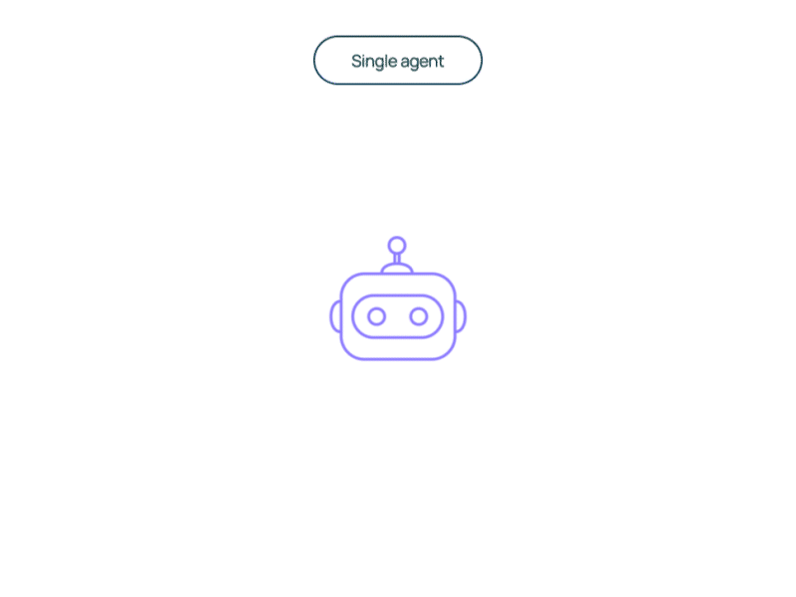
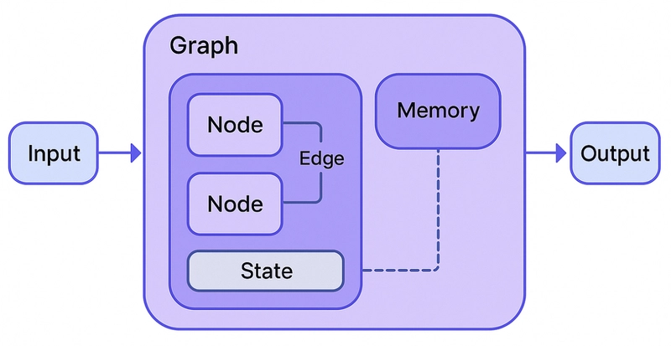
Project Objectives
What We Aim to Build
1. Fully open, reproducible agentic coding engine – Quantized StarCoder2 (3B/7B), LangGraph workflows, Python sandbox
2. Compare agentic paradigms – Read-Eval-Print Loop (REPL), Test-Driven Development (TDD), Self-Correcting, RAG
3. Enhance reasoning via efficient fine-tuning – QLoRA adapters on code + math datasets
4. Evaluate systematically – HumanEval Pass@1 – Ablations on agentic components
Notes:
To answer that,
First, Reproducibility. We aimed to build a fully open engine using quantized models, orchestrated by LangGraph.
Second, Paradigm Comparison. We didn't just want to build one agent; we wanted to compare different components and tools we used, specifically REPL based self correction versus Test-Driven Development (TDD) versus Retrieval Augmented Generation (RAG).
Third, Reasoning Enhancement. We investigated whether efficient fine-tuning could improve the model's ability in agentic loops.
And fourth, Systematic Evaluation. Compare performance on HumanEval benchmark, and ablations on agentic components

Slide 6
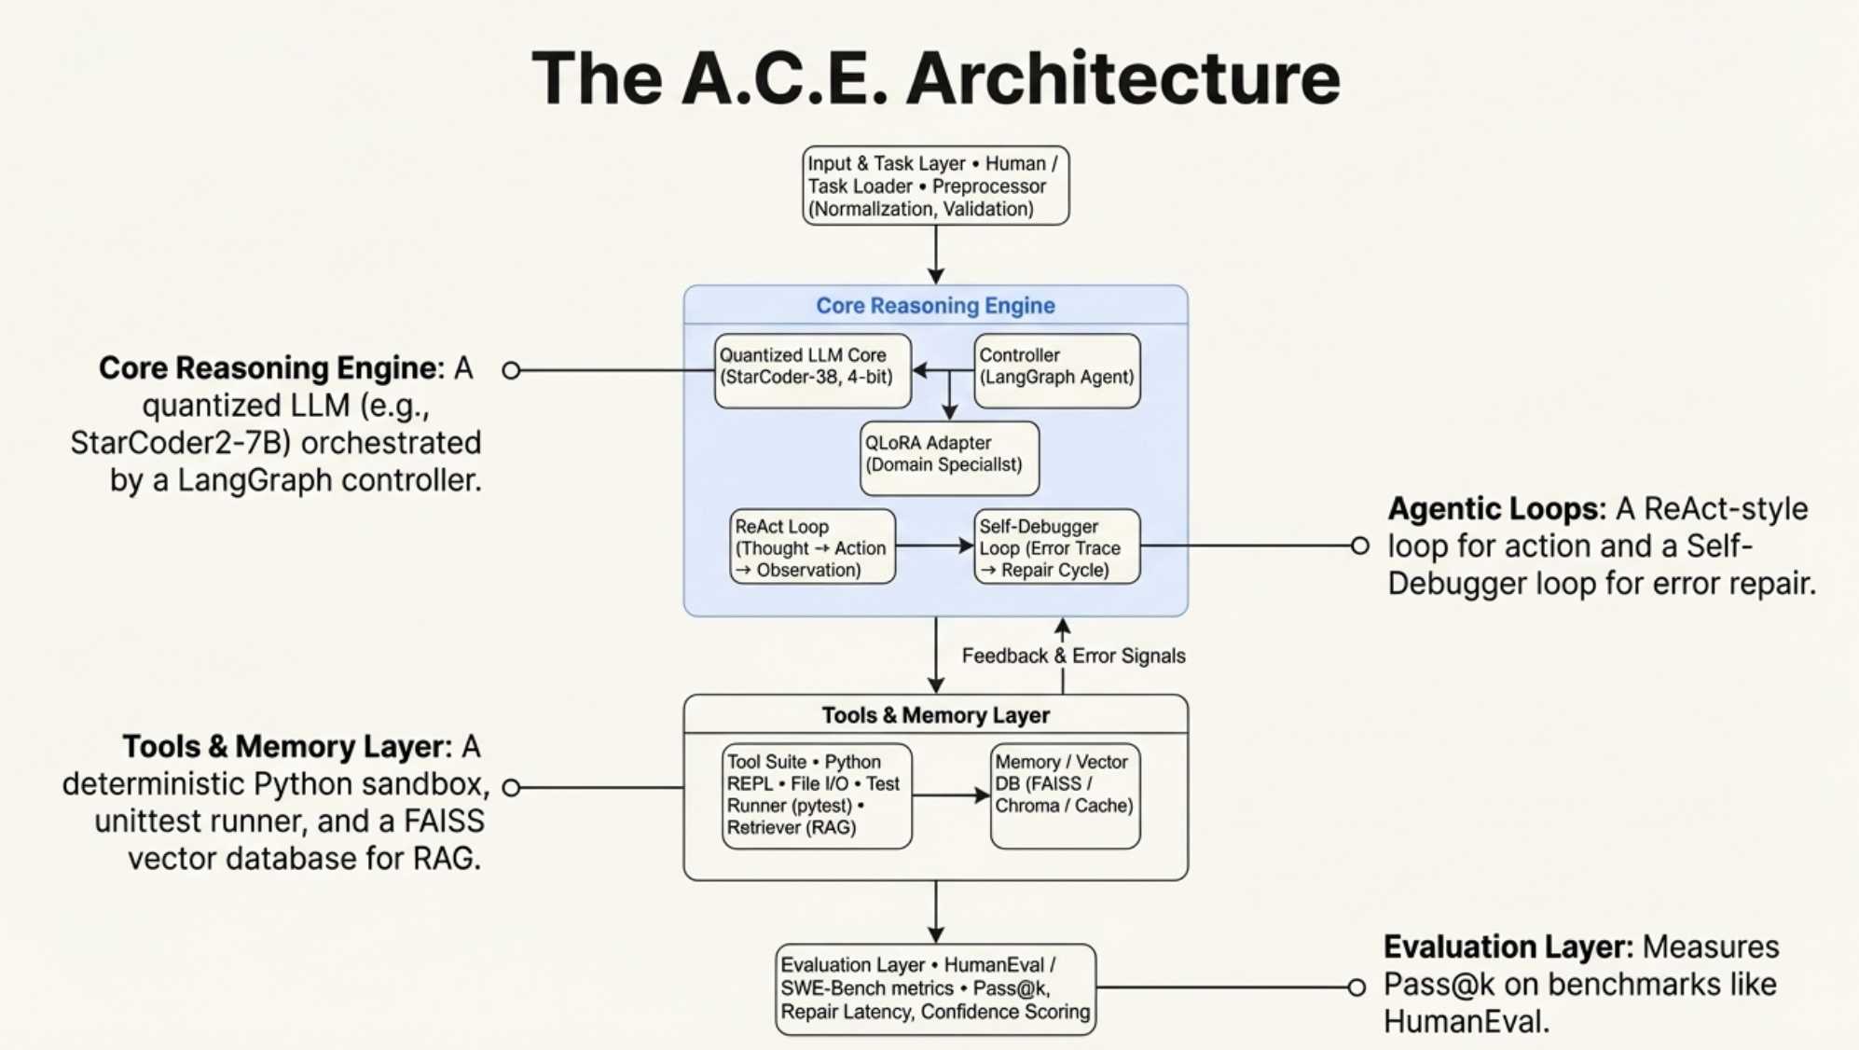
Notes:
At the center of A.C.E. is the Core Reasoning Engine. We use a 4-bit quantized StarCoder model controlled by LangGraph. This is crucial, it reduces VRAM usage to under 16GB, making it accessible.
Our agents are ReAct style loop with ability Thought → Action → Observation → Repeat.
Below that, we have the Tools & Memory Layer.
This includes a deterministic Python sandbox for safety, a dynamic test runner for verification, and a FAISS vector database for RAG.
# skip
The flow is circular, not linear. The agent generates a hypothesis, tests it in the sandbox, receives a structured error trace, and loops back to self-correct. This architecture turns a stochastic LLM into a reliable state machine. This architecture ensures that the model is never just 'guessing.' It is generating a hypothesis, verifying it against a compiler, and receiving structured feedback.

Slide 7
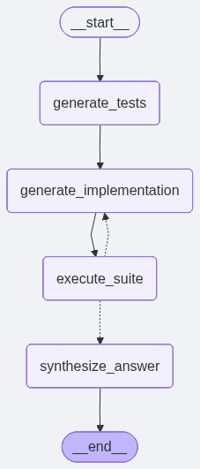
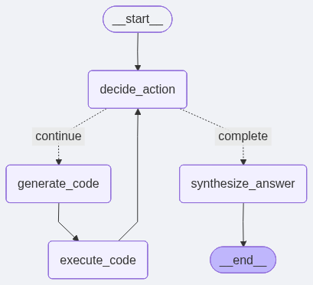
Agentic Paradigms
Four Agents in A.C.E.
REPL Agent → Generate → Execute → Analyze errors → Repair
TDD Agent → Generate tests first → Implement → Run → Repair
Self-Correcting Agent → Repairs both code and tests → Uses web search for missing APIs
RAG Agent → Injects retrieved documentation into reasoning → Improves API correctness
Notes:
Our agentic workflow is centered around the following.
A REPL Agent, focused on brute force generating code, executing it, capturing error traces, and attempting patches. It mimics a novice programmer debugging via trial and error.
Second is a TDD Agent: This agent follows software engineering best practices. The agent writes the unit tests before writing an implementation, forcing the model to fully internalize the problem specification before writing a single line of solution code.
Next is the Self-Correcting Agent who has higher privileges than the previous two agents. It can modify both the solutions and the tests. This is powerful but risky, as models have been known to 'cheat' by avoiding/deleting valid tests to pass.
Finally, we have a RAG Agent to retrieved code snippets and API documentation into the context window to ground the generation in reality.
By comparing these, we move beyond 'does it work?' to 'how does it solve problems?'

Slide 8
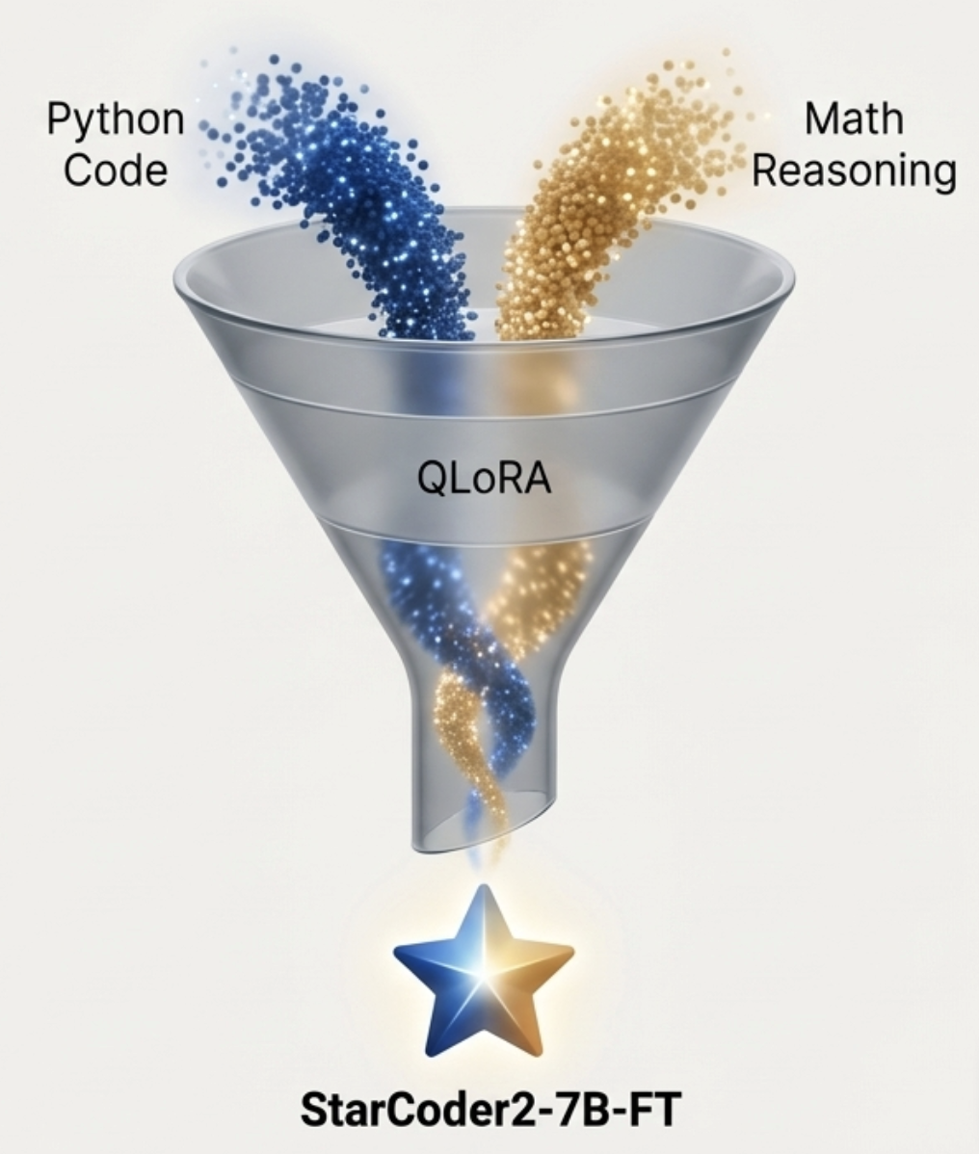
Fine-Tuning (QLoRA)
StarCoder2-7B-FT
Trained on:
GitHub-code-clean (Python)
MATH23K (math reasoning)
Benefits:
Cleaner Python code
Fewer hallucinations
Stronger multi-step reasoning
More stable agent loops
Notes:
Scaffolding is important, but the model weights still matter. We utilized QLoRA (Quantized Low-Rank Adaptation) to create a specialist version of StarCoder2-7B.
We didn't just train on Python code. We included MATH23K, a mathematical reasoning dataset.
Why math for a coding model?
We found that coding agents often fail not because they don't know Python syntax, but because they fail at multi-step logic. By injecting math reasoning into the adapters, we observed cleaner code, fewer hallucinations, and significantly more stable agent loops. The model became better at following the rigid state transitions required by LangGraph

Slide 9




Implementation Details
Core Model Integration
4-bit NF4 quantized inference with StarCoder2.
QLoRA adapters fusion supported
LangGraph state machines:
Typed states
Explicit transitions
Transparent trace logs
Sandboxed Execution Engine
Code executed inside isolated Python venv subprocesses with zero shared globals.
Built-in safety: import whitelisting, timeouts, SIGKILL fallback, exception wrapping.
Test execution uses custom unittest runner with captured stdout + structured reports.
RAG retrieval with FAISS
FAISS index built with vector size = 768.
Encoder = MiniLM-L6.
Retrieved chunks inserted using template-controlled context blocks to avoid prompt drift.
Logging, Telemetry & Debugging
Agent traces recorded via LangSmith.
Gradio UI integrated with a real-time log viewer.
Evaluation Pipeline Integration
HumanEval executed through CodeChain-compatible evaluators.
Each model run spawns a fresh Python kernel for consistency.
Automation scripts written to batch-run Pass@1, ablations, and agent iteration caps.
Notes:
Model Integration: We use 4-bit NF4 quantization. This allows us to run the 7B model and the adapter fusion with minimal latency.
State Management: We moved away from 'prompt engineering' to 'flow engineering' using LangGraph. We have typed states and explicit transitions—if the tests fail 3 times, we force a specific 'Reflect' state.
Sandboxing: Security is paramount. All code runs in isolated subprocesses with timeouts and SIGKILL fallbacks. We capture stdout and stderr to feed back into the model.
RAG: We use a FAISS index with a MiniLM encoder. Crucially, we use template-controlled context blocks to prevent the retrieved documents from confusing the small model's limited context window.
TO BE WRITTEN PROPERLY

Slide 10
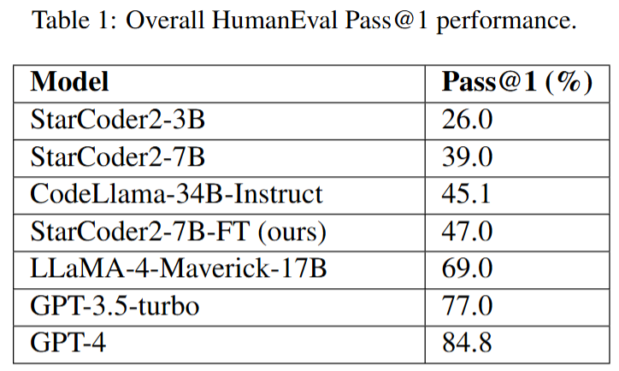

Evaluation Results
Takeaway :
Structured reasoning (TDD, REPL, repair cycles) narrows the gap between 7B open models and much larger proprietary models, agentic scaffolding boosts capability beyond raw model size.
Notes:
Now, let's look at the results. This table compares Pass@1 performance on HumanEval.
Our baseline StarCoder2-3B sits at 26%. The 7B base model is at 39%.
The industry standard open model, CodeLlama-34B, scores 45.1%
Our StarCoder2-7B-FT (Fine-Tuned), wrapped in the A.C.E. framework, achieves 47.0%.
We are outperforming a model five times our size (CodeLlama-34B). While we are not yet beating GPT-4 (at 84%), we have drastically narrowed the gap between open, lightweight models and proprietary giants, purely through better architecture and fine-tuning.

Slide 11
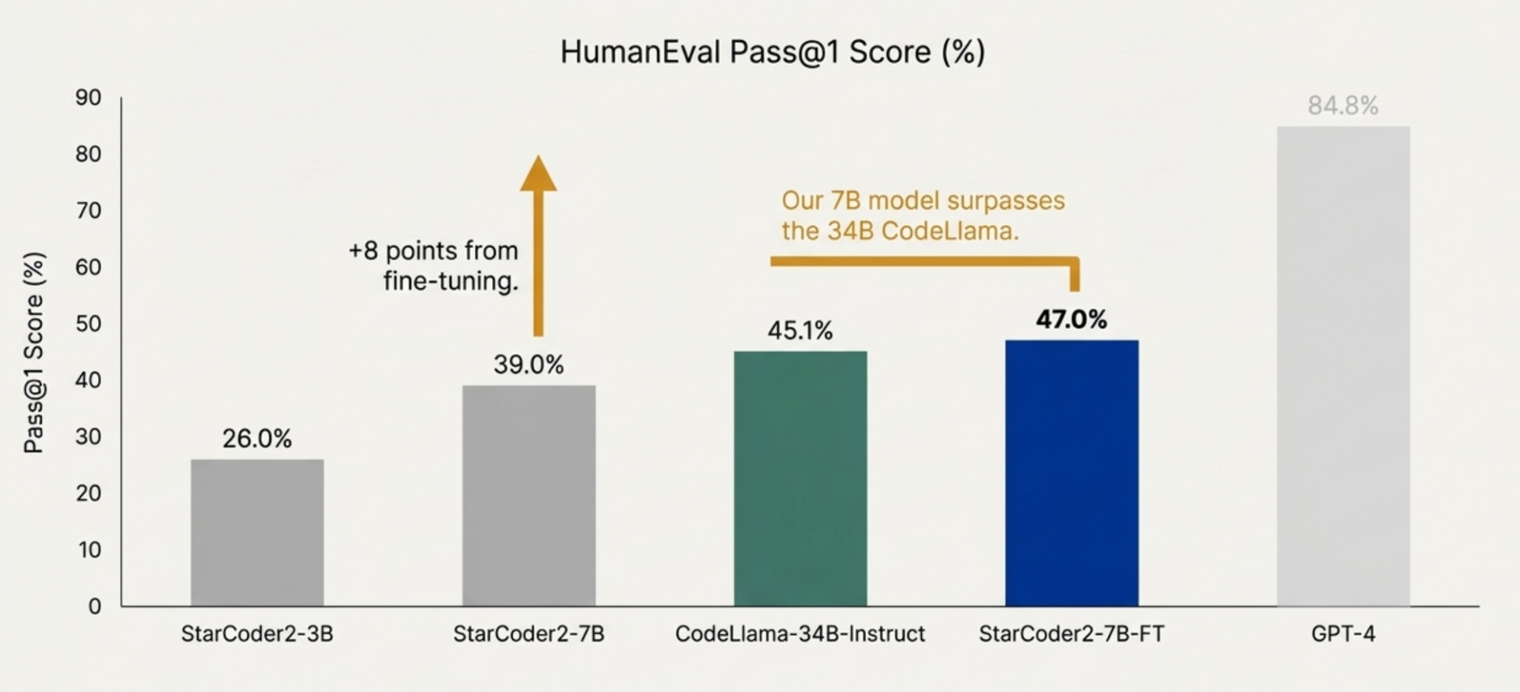
Our fine tuned agent seems to perform better than a model 5x the size. Smart fine tuning unlocks performance beyond scale.
Notes:
To visualize that impact, look at this trajectory.
The gray bar on the left is the raw model. The jump to the blue bar—47.0%—represents the synergy of Fine-Tuning and Agentic Scaffolding.
Specifically, fine-tuning gave us an 8-point boost over the base model.
This result challenges the 'Scale is All You Need' hypothesis for coding tasks. It suggests that 'Smart Fine-Tuning + Agentic Loops' can be a substitute for raw parameter count. We are effectively unlocking 30B-level performance on a 7B-level hardware budget.

Slide 12
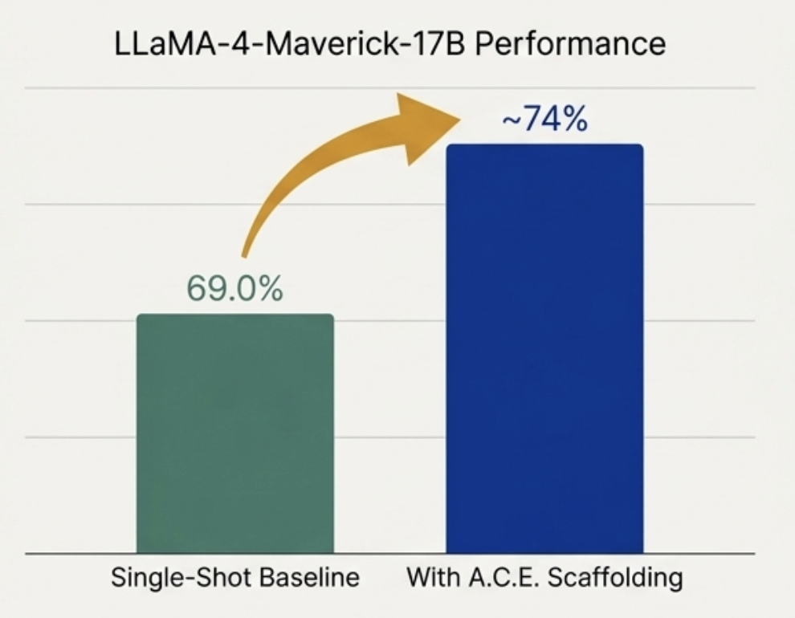
Structured agentic workflows boost all model sizes, not just small open-source models.
LLaMA-4-Maverick-17B improves from 69% → ~74% Pass@1 when wrapped in A.C.E.’s TDD + execution-feedback loop.
Agentic scaffolding acts as a force multiplier, enabling even frontier models to reason more reliably and correct their own errors.
Notes:
A skeptic might ask: 'Did you just overfit StarCoder?'
To test generalizability, we applied the A.C.E. scaffolding, without any finetuning, just the TDD and self repair loop, to a completely different model: LLaMA-4-Maverick-17B.
The results were consistent. The model improved from a 69% baseline to roughly 74% Pass@1.
This confirms that A.C.E. acts as a force multiplier. It doesn't matter if the underlying model is 7B or 17B; wrapping it in a structure that forces it to plan, test, and repair yields a net positive gain in reliability. The 'Test-Driven' workflow improves reliability regardless of the underlying backbone, helping even stronger models catch edge cases they would otherwise miss.

Slide 13
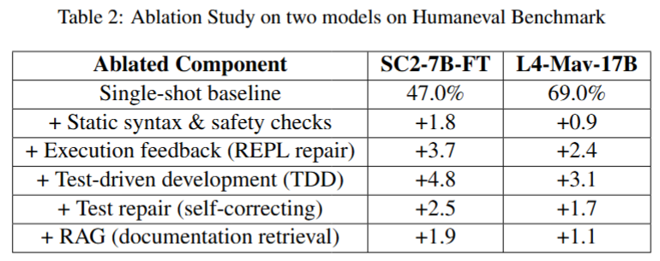
Ablation Study
Qualitative Observations from Agents
REPL
Strong at fixing local errors (off-by-one, boundary cases).
Weak when initial reasoning is incorrect → gets stuck in repeated patch loops.
TDD ( Test Driven Development )
Generates structured tests first → better coverage of edge cases.
Unittest feedback gives precise error signals → faster convergence in 2–3 iterations.
Could be constained by the initial error in the testcases generated
Self-Correction
Repairs both tests and implementation → avoids being trapped by incorrect tests.
Risk of cheating / reward hacking : may overfit test repairs instead of aligning with the true specification.
Takeaway
Different agent types contribute different reasoning strengths; combining them yields more stable and robust improvements.
Notes:
Numbers tell us what happened, but we need to understand why. We conducted a qualitative ablation study of the different agent types.
REPL Agent: It was strong at fixing syntax errors (off-by-one errors), but if the initial logic was flawed, it got stuck in a loop, repeatedly patching code that was fundamentally wrong.
TDD Agent: This was our strongest performer. By generating tests first, the model creates a 'specification' for itself. This guides the code generation and prevents logic drift.
Self-Correction: This was a double-edged sword. While it prevented the agent from getting stuck, we occasionally saw it 'fix' the test to match the broken code, effectively cheating to pass. This highlights the need for a 'Critic' role in future iterations."

Slide 14
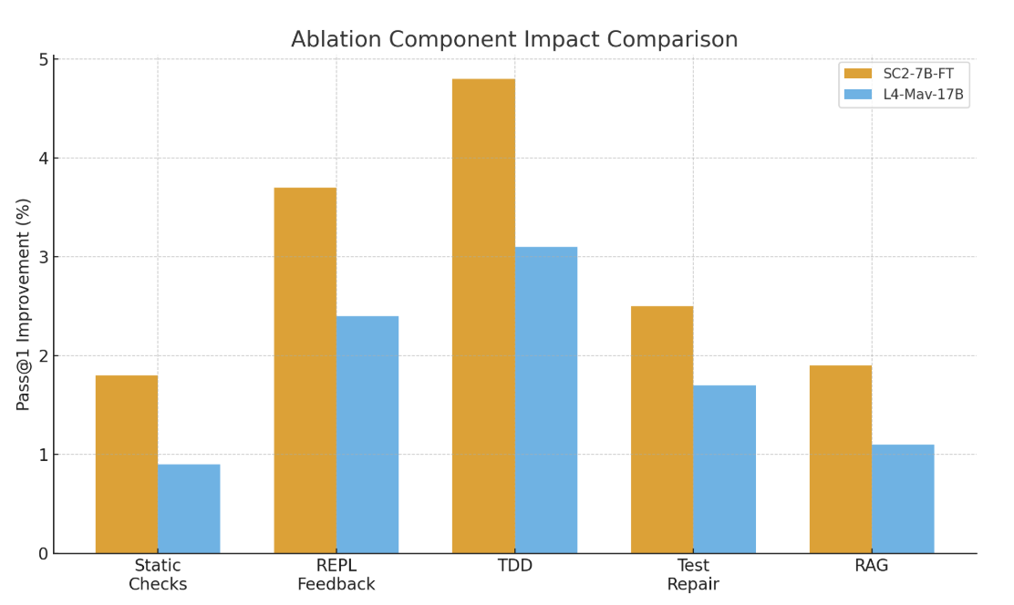
Ablation Study
Performance Gains Across Models (StarCoder2-7B-FT & Maverick-17B)
Static checks: small but consistent improvements (syntax validity prevents cascading failures).
Execution feedback: large gains when model’s first attempt is close but not perfect.
TDD: strongest structured improvement; forces explicit specification before implementation.
Test-repair: resolves brittle or wrong tests; crucial for ambiguous tasks.
RAG: helps with API grounding; modest improvement overall.
Key takeaway from ablation study:
TDD > REPL > Test-Repair > Static Checks > RAG
Fine-tuning + agentic structure = strongest combined effect for small/medium models.
Notes:
Quantifying those observations, this chart breaks down the contribution of each component.
The tallest bar you see is TDD (Test Driven Development). It offers the single largest jump in performance.
REPL Feedback is a close second—simply telling the model why it failed is incredibly high-value.
Interestingly, RAG (on the far right) provided the smallest gain. We suspect this is because HumanEval is logically dense but uses standard Python libraries. RAG helps with obscure APIs, but for algorithmic logic, reasoning loops (TDD) are far more valuable than retrieval

Slide 15
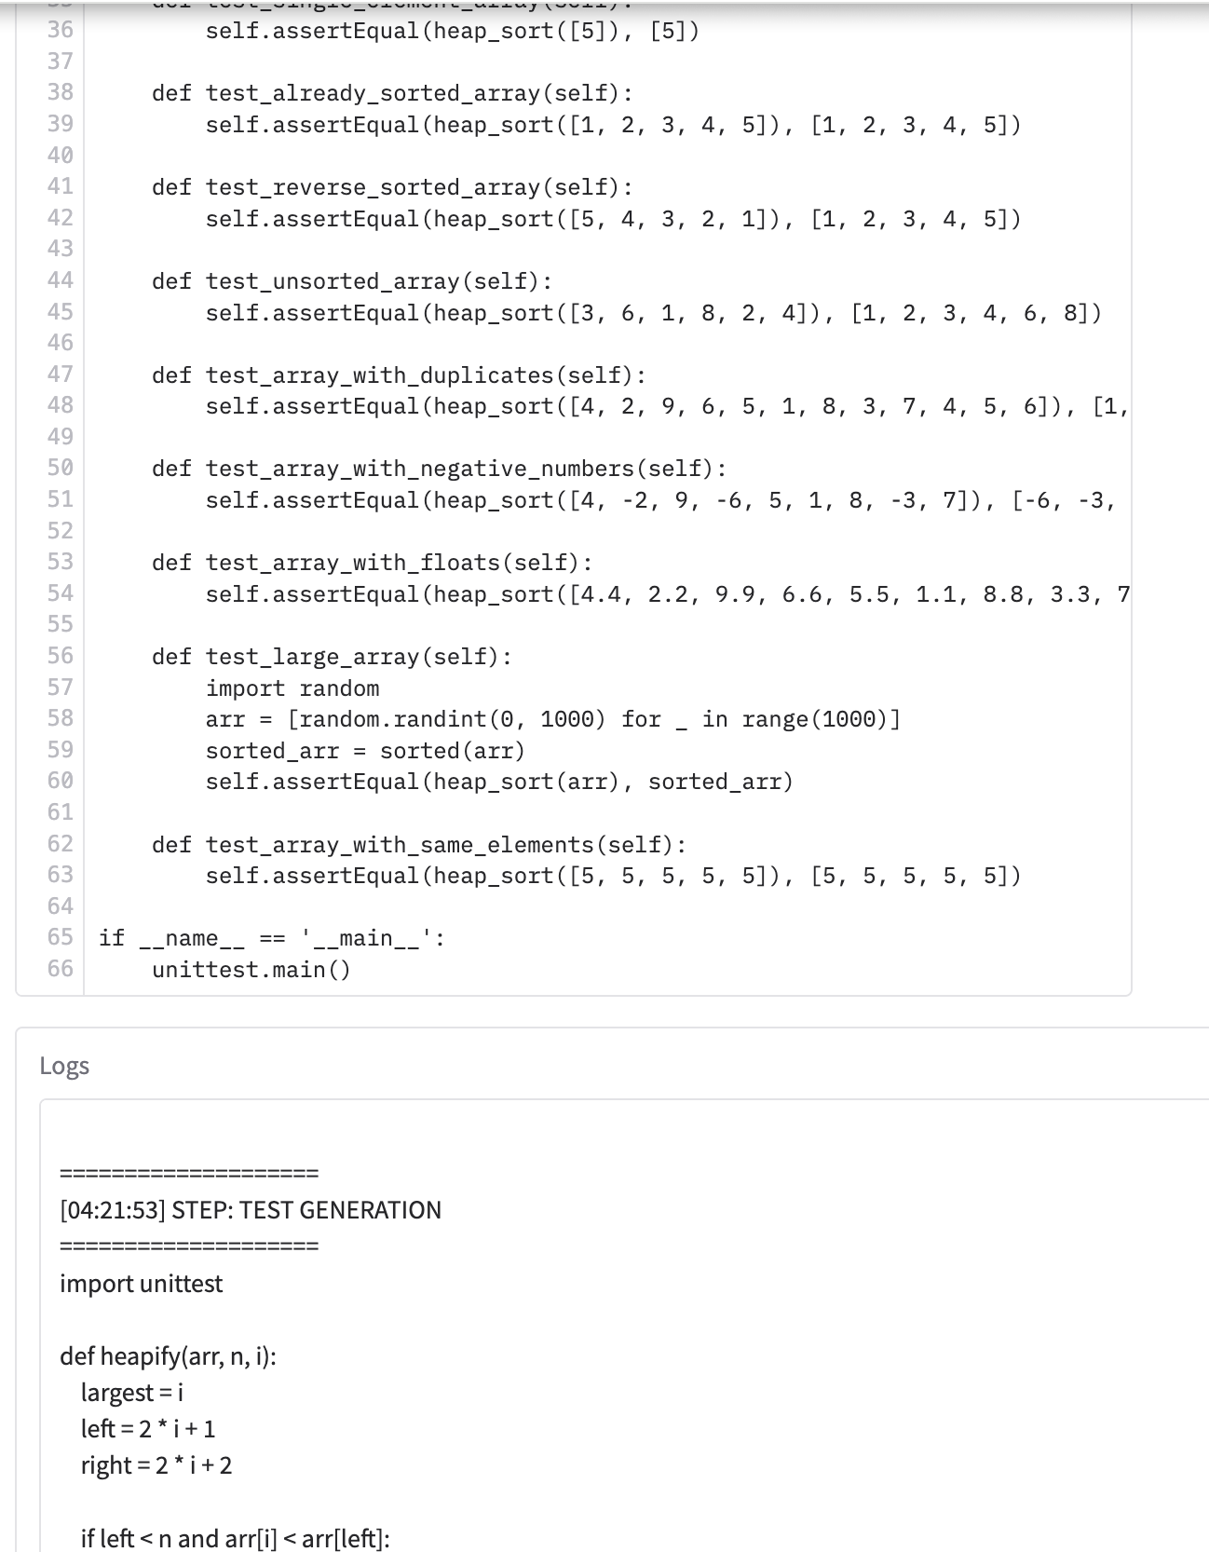
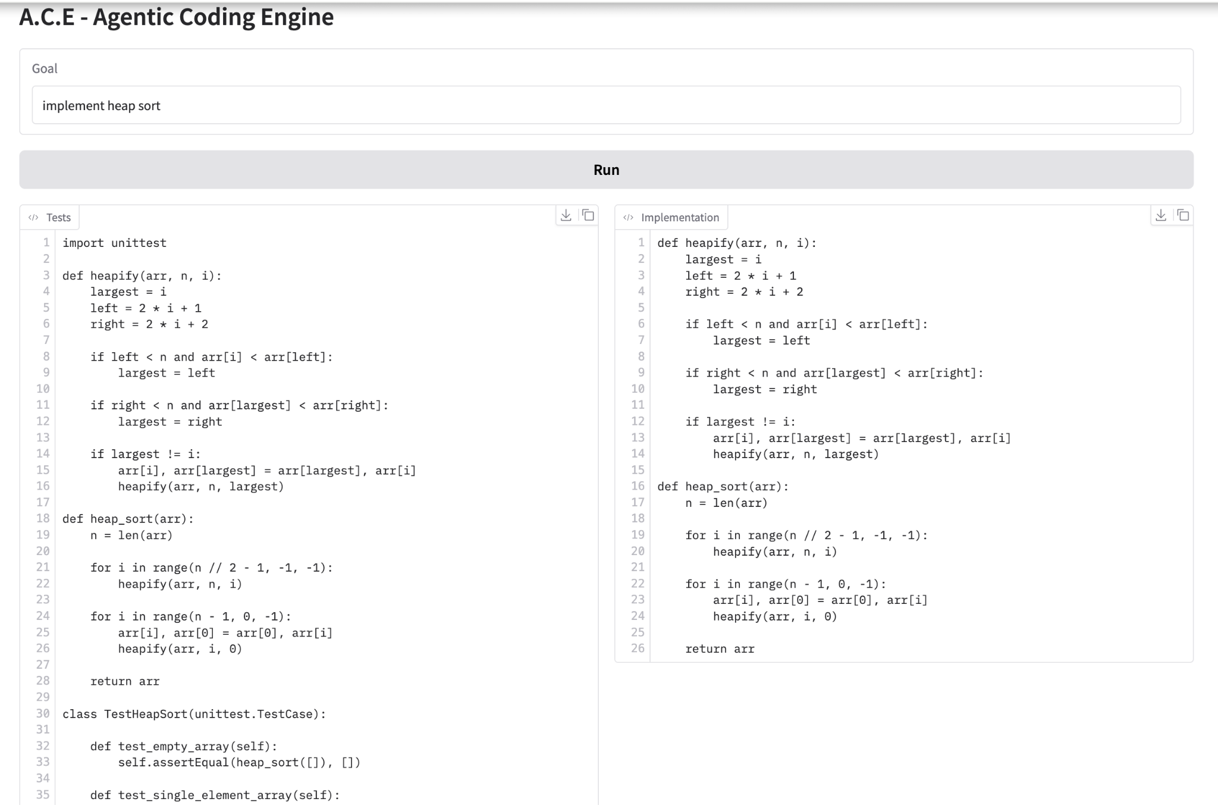
Gradio Interface with full A.C.E
Notes:
We believe research should be touchable. We built a full Gradio interface for A.C.E.
On this screen, you see the user inputs a goal—'implement heap sort'.
The system doesn't just spit out code. It begins by generating a test suite (visible in the left panel), then generates the implementation (right panel), and runs them against each other.
This interface allows us to visualize the 'thinking process' of the agent in real-time

Slide 16
A.C.E. Interface :
From Black Box to Glass Box
Entire loop: generated tests, implementation, and execution logs side-by-side.
Users can trace every decision , test generation, code attempts, failures, fixes.
Makes the system fully inspectable, unlike black-box LLM coding tools.
The agent generates unittest suites automatically before coding (TDD workflow).
Execution logs show precise failures, enabling targeted repairs.
The implementation panel updates as the agent iteratively refines its solution.
Notes:
We call this the 'Glass Box' approach, as opposed to the 'Black Box' of few commercial tools.
In A.C.E., the user sees the Test Generation, the Implementation, and the Execution Logs side-by-side.
If the agent fails, you see exactly why, you see the stack trace and the agent's attempt to fix it.
This transparency is critical for adoption, since transparency builds trust. Developers don't trust magic; they trust logic they can verify. A.C.E. makes the verification process explicit.
A.C.E. demonstrates that you don't need a data center to build state-of-the-art coding agents. With smart scaffolding, robust testing loops, and efficient fine-tuning, we can democratize access to agentic AI

Slide 17
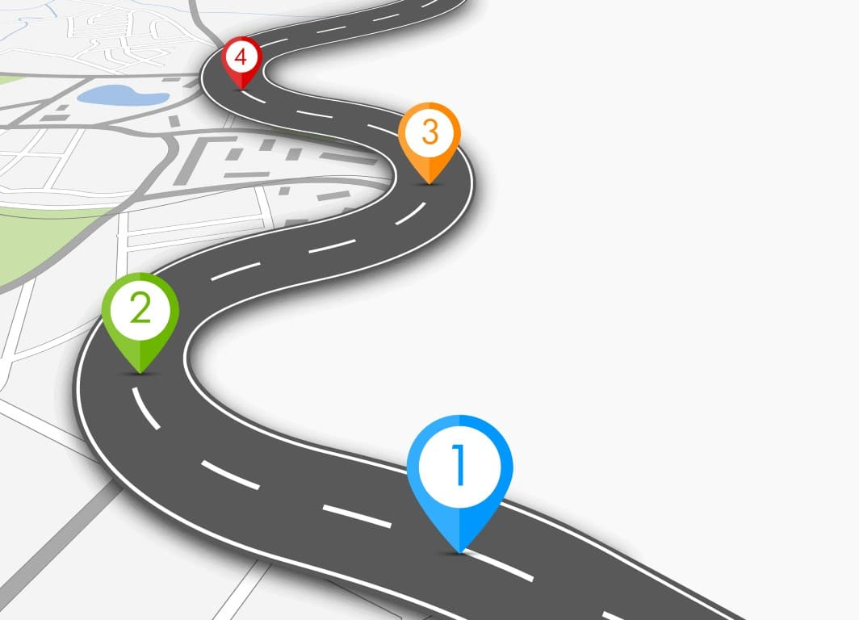



Future Directions
Human-in-the-Loop Agentic Refinement
Broader Benchmarking
Future Directions
Richer Retrieval & Context Management
Scaling Agentic Reasoning
Notes:
Our work with A.C.E. is just the beginning. We have identified key avenues for future work:
Scaling Agentic Reasoning: We want to test this on 70B models to see if the gains scale linearly.
Richer Retrieval: Our RAG implementation was basic. We plan to integrate broader context management, perhaps traversing entire repositories rather than just snippets.
Human-in-the-Loop: We want to allow the user to interrupt the agent during the 'Glass Box' visualization to offer corrections, say for example during writing tests, and verify if agent is solving the right problem, turning the agent from an autonomous worker into a collaborative pair programmer.

Slide 18
References
1] Ashok K. Chandra, Dexter C. Kozen, and Larry J. Stockmeyer. Alternation. Journal of the ACM, 28(1):114–133, 1981.
[2] Ming Chen and Hao Zhou. Retrieval-Augmented Generation for Large Language Models: A Survey. arXiv:2402.19473, 2024.
[3] Rui Chen, Lingfeng Zhao, and Ming Gao. Aflow: Automating Agentic Workflow Generation. arXiv:2410.10762, 2024.
[4] Tim Dettmers, Mike Lewis, Sam Shleifer, and Luke Zettlemoyer. QLoRA: Efficient Finetuning of Quantized LLMs. arXiv:2305.14314, 2023.
[5] Edward J. Hu, Yelong Shen, et al. LoRA: Low-Rank Adaptation of Large Language Models. arXiv:2106.09685, 2021.
[6] Dong Li, Rui Peng, et al. AgentCoder: Multi-Agent-Based Code Generation with Iterative Testing and Optimisation. arXiv:2312.13010, 2023.
[7] Raymond Li, Yacine Belkada, et al. StarCoder: May the Source Be with You! arXiv:2305.06161, 2023.
[8] Tianyu Li, Han Xu, et al. SEW: Self-Evolving Agentic Workflows for Automated Code Generation. arXiv:2505.18646, 2025.
[9] Hugo Touvron, Thibaut Lavril, et al. LLaMA: Open and Efficient Foundation Language Models. arXiv:2302.13971, 2023.
[10] Jiawei Wang, Rong Chen, et al. Self-Organizing Multi-Agent Systems for Code Generation and Task Decomposition. arXiv:2409.08765, 2024.
[11] Yuxin Wang, Zhihan Liu, Wenxuan Huang, et al. AI Agentic Programming: A Survey of Techniques, Challenges, and Opportunities. arXiv:2508.11126, 2025.
[12] Kun Xu, Junjie He, and Rui Wang. A Survey on Large Language Models for Code Generation. arXiv:2406.00515, 2024.
[13] Ming Yang, Yue Zhao, et al. CodeCoR: An LLM-Based Self-Reflective Multi-Agent Framework for Code Generation. arXiv:2501.07811, 2025.
[14] Hao Zhang, Yue Lin, et al. A Survey on Code Generation with LLM-Based Agents. arXiv:2508.00083, 2025.
[15] Wei Zhang, Chen Luo, et al. AutoCoderOver: Autonomous Program Improvement. arXiv:2404.05427, 2024.

Slide 19
Q&A

Slide 20
Thank You
Thank You

